Slide 1
2.1 Z-scores, Density Curves and Measures of Relative standing

Slide 2
In this section, you will learn to compare a score of a test or any result/data point relative to all other scores or data points
Q: Suppose you wrote a test and got 90%. Later you realize that everyone also got around 90%. Even the kid that usually fails also got around 90%. How would you feel about your result relative to other scores in the class?
Answer: I would be inclined to use my score to reduce any self esteem issues, but since everyone got around the same score, it could mean that the test was easy and my score wasn’t much better compared to the class.
1st Test (90%)
2nd Test (65%)
Q: What if you wrote a test and got 65% instead? Later you realize that the entire class got less than 45%. How would you feel about your result relative to other scores in the class?
Despite getting a good mark of 90%, the relative standing of your score is just average
Although 65% may seem like a bad mark, the relative standing compared to the class is very high. This means that you did very well compared to other students in the class
Answer: I would be inclined to beat myself for getting anything less than an Asian fail. However, since my relative standing compared to the entire is much higher, it means that I scored better than everyone else in a difficult test. I would feel better about my score.

Slide 3
Z-scores! What are Z-scores?
Z-scores and normal distributions can be used to compare how a data point is relative to every other data point in a distribution
Your z-score indicates how many SD’s above or below the mean
Ie: A z-score of +1 means your score was 1 SD above the mean, 78th percentile
A z-score of -2 means that your score was 2 SD below the mean, 84th percentile
Using your z-score instead of the actual data point allows you to compare your results relative to the score of your class

Slide 4
Q: There are two students: “A” and “B” in two different classes:
Student A: 80%
Student B: 87%
Q: Which student did better? How would you justify it?
You can measure the success of a student’s mark based on how many standard deviations above or below the class mean
Student A scored 5 std dev. above their class average. While student B score around 1.6 std dev above their class average. Therefore, student A did better relative to their class.
NOTE: Look at their “Z-score” and not just their test score

Slide 5
Standardizing a Value:
When we ‘standardize’ a data value, you convert it to a “Z-score” that tells you how many std deviations above or below the mean
To find your z-score, find the difference between your score and class average. Then divide this difference by the SD. This will tell you how many std dev. your score is above/below the mean
Value of the data point
Population mean
Population standard deviation
NOTE: The z-score is used only when the distribution is “Normally distributed” (BELL SHAPED CURVE)

Slide 6
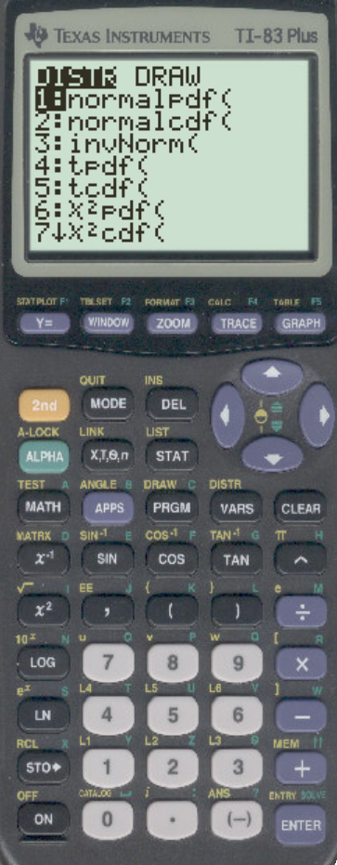
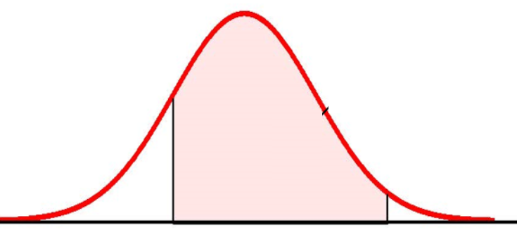
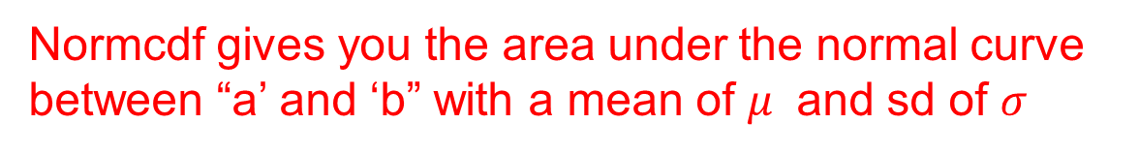
What to MASTER!!??!
In your Ti83, there are two functions that you must learn:
Normcdf gives you the area under the normal curve between “a’ and ‘b” with a mean of $μ$ and sd of $σ$
“a’ is lower limit, “b” is upper limit, cdf: cumulative distribution function
Normalcdf will give you area of this curve as a percentage between 0 to 100%

Slide 7
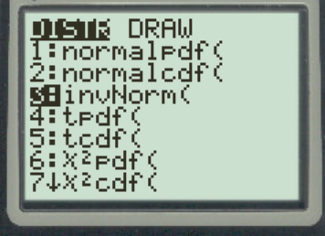
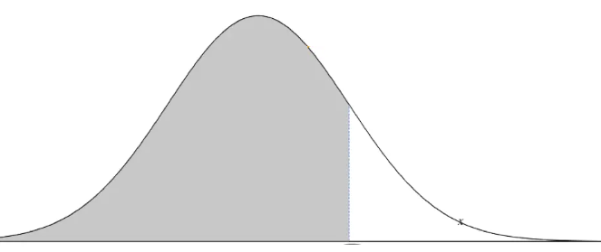
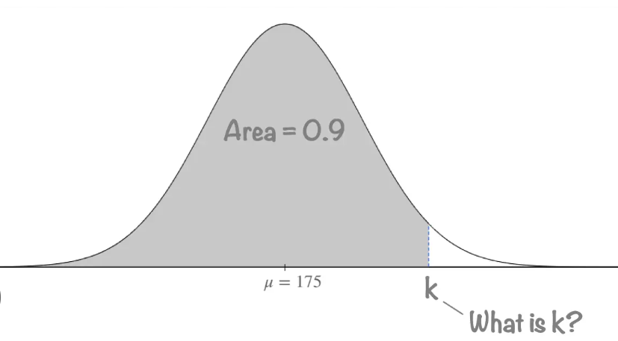
The second function to master is inverse Normality
The inverse norm function can give you either the
‘Z-score” or the actual value of the data point
Z-Score:
Data Point:

Slide 8
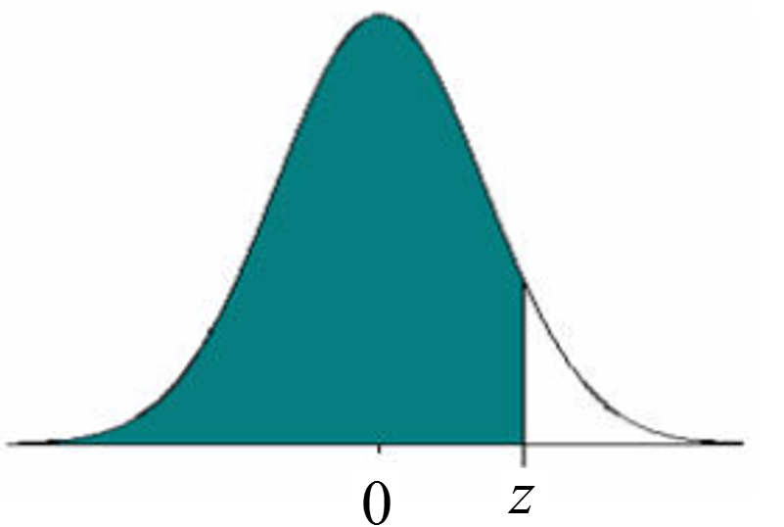
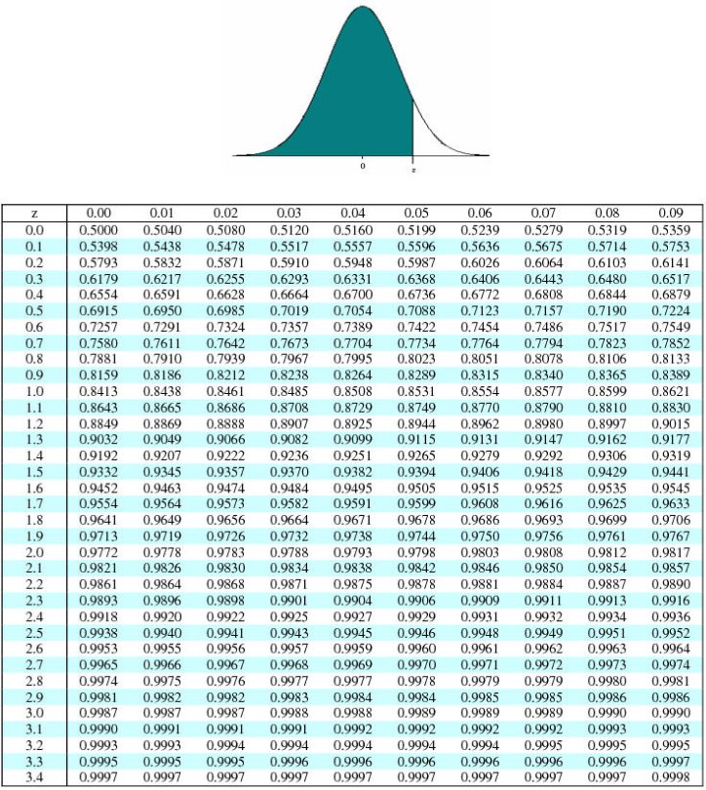
Using the Z-score Table
This table is for finding the percentage area less than your z-score (percentile)
Use the left column gives the first z-score to one decimal place
The top row gives the 2nd decimal value
The numbers in the middle represent the area to the left of the z-score (percentile)
Ie: z =1.85
This gives a left area of 96.78%
Your z-score is in the 96.78% percentile

Slide 10
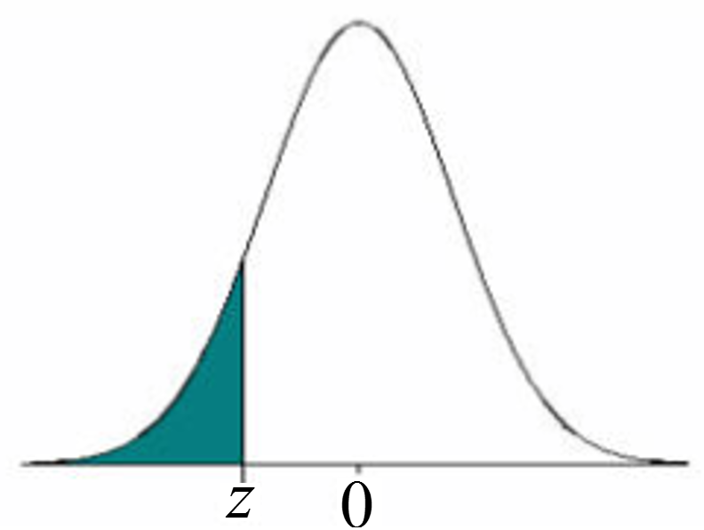
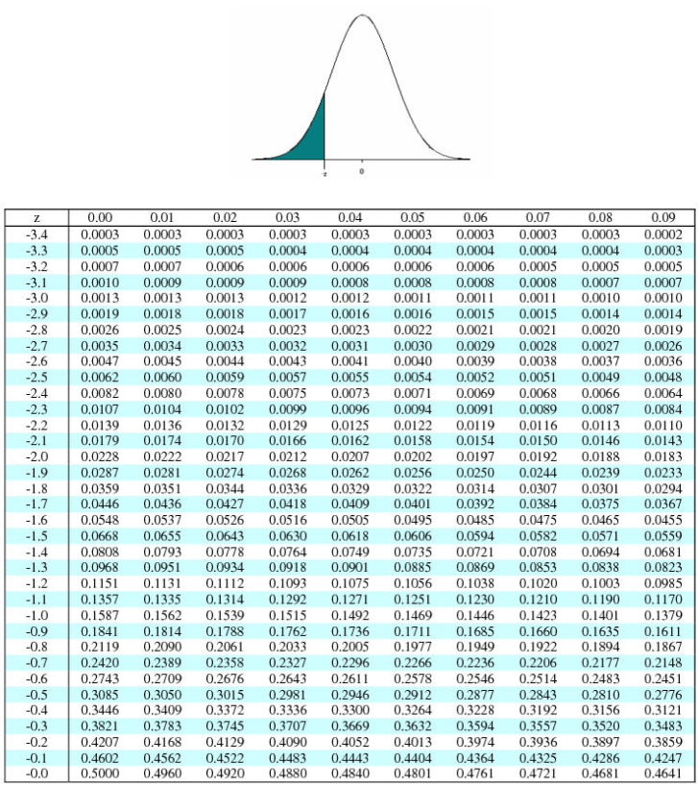
A negative z-score indicates that your score is less than the mean (average)
A z-score of -2.38 means that you are 2.38 standard deviations less than the class mean
A z-score of -2.38 gives a left area of 0.0087. This means that 0.87% of all scores is less than your. Which also means that you scored in the bottom 1%

Slide 12
Sally and her friends are in a class where the scores are approximately normally distributed. The mean score in the class is 70.5% with a std dev of 6.5%. Calculate the z-score for each percentage:
With a z-score of 1, Sally is in the 84th percentile, scoring in the top 16%
i) Sally (77%)
With a z-score of -1, Friend #1 is in the 16th percentile, scoring in the bottom 16%
ii) Friend #1 (64%)
With a z-score of -2.846, Friend #2 is in the bottom 0.22% of the class
iii) Friend #2 (52%)
iv) John scored in the 99th percentile. What score did he get?

Slide 13
Group Work:
The test scores on last chapter are displayed in the stem leaf plot below.
i) Find the mean and St Dev.
ii) Mark got 35. Calculate and Interpret his z-score. What percentile is he in?
iii) Sharon earned a 8. Calculate and interpret her z-score. What percentile is she in?
iv) On the next test, the mean was 28 and st. dev was 14 Mark got 39 on this test. On which test did he perform better relative to the rest of the class. Explain:

Slide 14
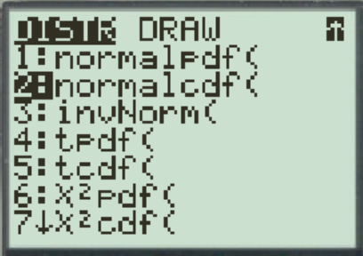
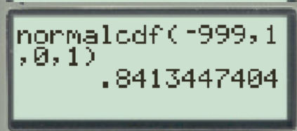
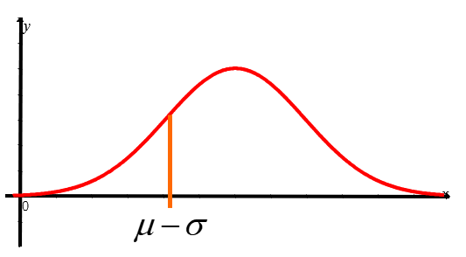
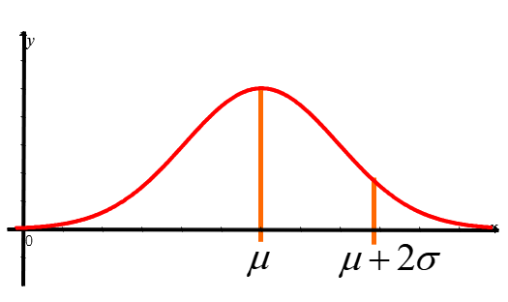
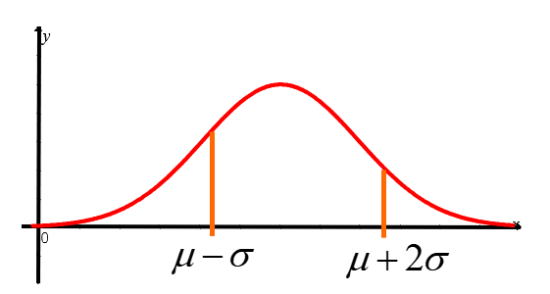
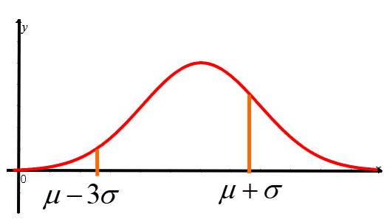
Your Ti-83 can be used to find the area between any two z-scores (a, b)
Press 2nd Vars
The area to the left of a z-score of 1 will be equal to 84.13%
Practice: Find the areas of the shaded region:

Slide 15
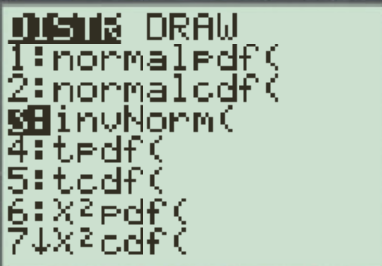
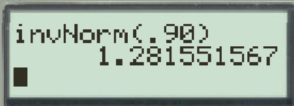
Inv-Norm(Area) = z-score
Inv-Norm(Area, mean, std dev) = data point
Another useful function on your Ti-83 is finding the z-score when you are given the area
Use Inverse Normal (Area), the corresponding
z-score will be given
IF the area to the left is 90%,
the z-score value is 1.2815515
Practice: Find the Z-score given the area:
y
y
0
x
0
x

Slide 16
Ex: Tom’s math class had a test that was out of 60. The average score of the class was 42 with a standard deviation of 5.5.
a) If Tom got 53, what percentile was he in?
b) His girl friend, Sharon, scored in the 98th percentile. What score did she get?
c) His buddy Jim scored in the 40th percentile, what score did he get?
d) What percentage of the class scored between 30 to 50?
e) Another buddy of his, Mark, was in another class where the mean score was 50 with a standard deviation of 3.5. His buddy scored 52 on that test. Did his buddy Mark do better that him relative to their own classes?

Slide 18


The COMC is a math competition out of 80. Jack scored 67 (98.74%) and Angel scored 57(93.78%). What is the mean and SD of all writers?
First find the value of z-score of both student using InvNorm
InvNorm(98.74)=
InvNorm(93.78)=
Next, plug the values into the z-score formulas:
Solve the system of equations by subtracting the two equations:
The average score of all COMC writers of that year is 35.092 with
a SD of 14.257

Slide 19
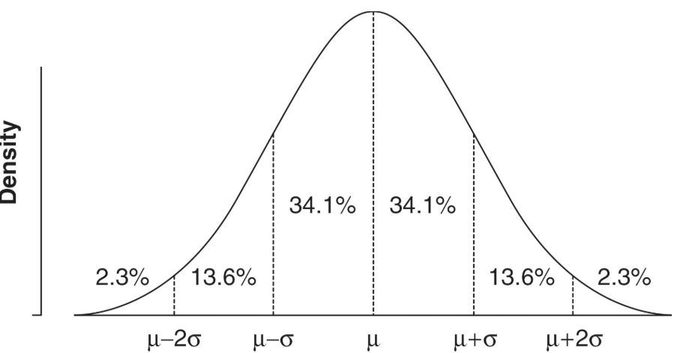
Area under Normal Distribution within several Std Deviations:
“approximately Normally distributed”
  Density curve is symmetrically distributed, single peaked, bell shaped, and data set follows the approximations of the 68,95,99.7 rule

Slide 20
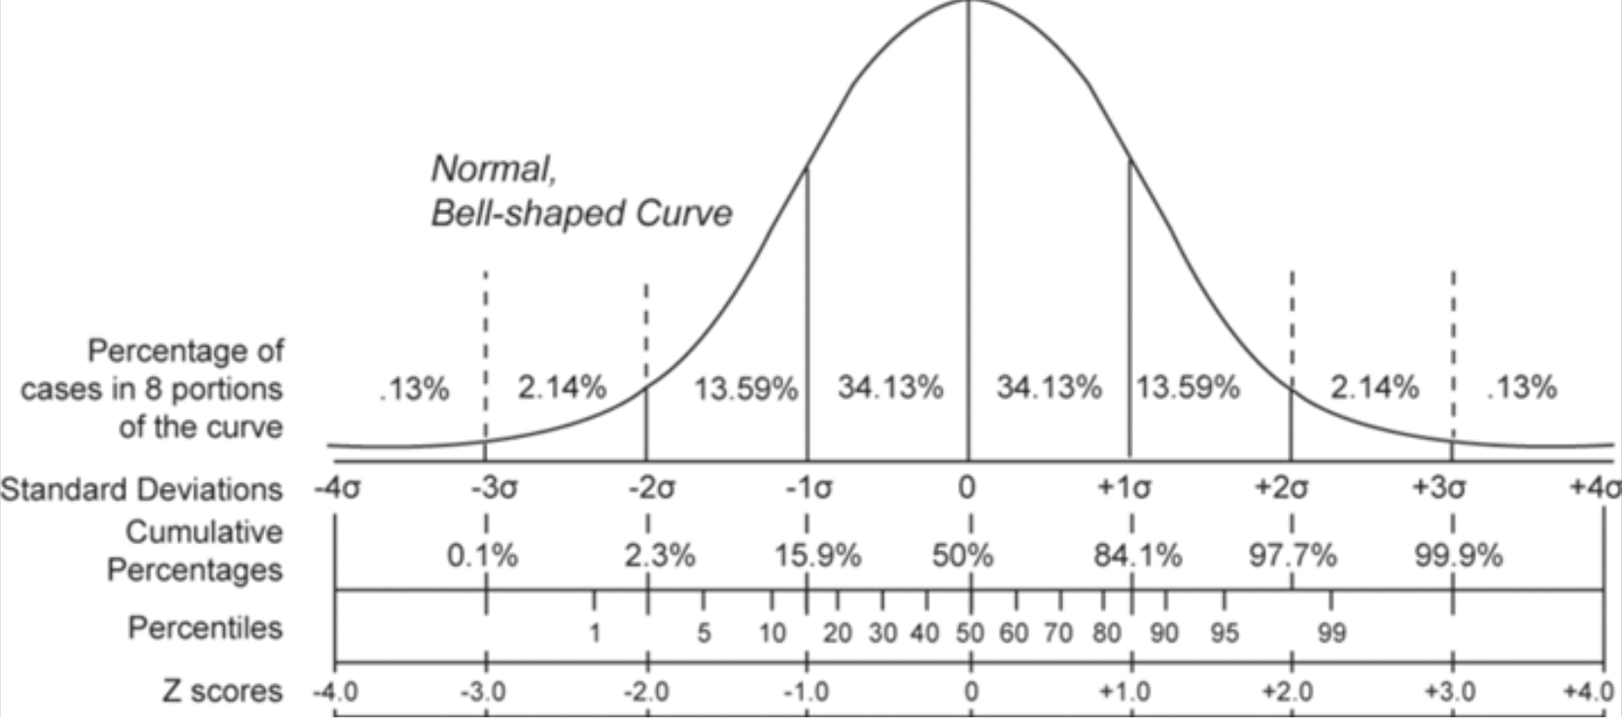
Jim is in a class where the scores are approximately Normally distributed. If the mean score is 80% with a std dev of 5%, which of the following formula will give the score at the 75th percentile?

Slide 21
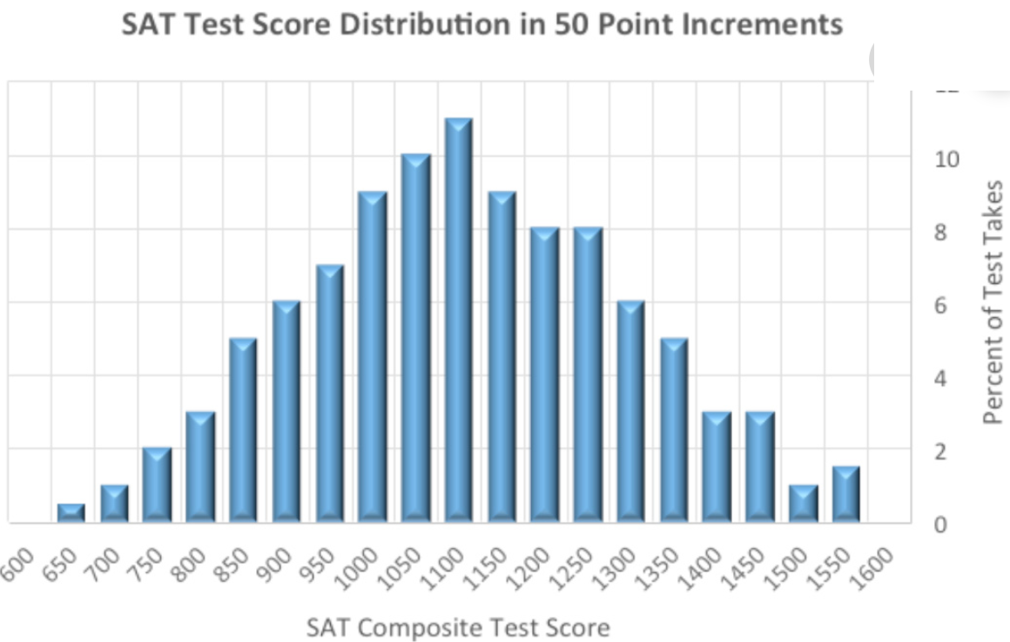
Ex: Julie wrote the SAT in her school district with 700 other students. The highest possible score is 1600. The distribution of scores is given below:
N Mean Median stDev Min Max Q1 Q3
700 1060 1085 195 640 1570 1040 1254
a) How would you describe shape of this density curve
b) Julie scored 1470 on the SAT. Describe the location of this value within the distribution using raw data, percentiles, and standardized values (z –scores). How many students did better than her?’’

Slide 22
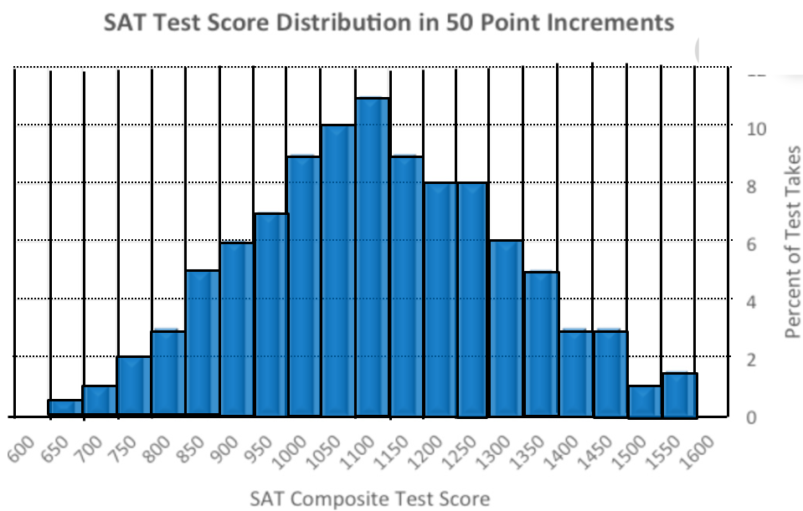
Sketch a density curve for summarizing the histogram
How would you describe shape of this density curve
Julie scored 1470 on the SAT. Describe the location of this value within the distribution using raw data, percentiles, and standardized values (z –scores). How many students did better than her?
The shape of this density curve is relatively symmetrical, centered around the median of 1085. The IQR is from Q1: 1040 to Q3:1254, with a range of 214. Finding 1.5xIQR= 321, the min score of 640 is an outlier. [1040-321=719]. The data is slightly skewed left.
Find the z-score:
She scored in the 98.21 percentile, so only 1.79% of students did better than her. Out of 700, this means approximately 13 students did better than her.

Slide 23
Definition of a Density Curve?
A curve that describes the overall pattern of a distribution
All Density Curves have an area of 1 or 100%
Entire graph must be above the X-axis
Normal Distribution – Bell Shaped Curve
The area under the curve and above any interval of values on the horizontal axis is the proportion of observations that fall in that interval
0.7
y
0.6
0.5
0.4
0.3
0.2
0.1
x
0
0.5
1
1.5
2
2.5
3
3.5
4
4.5
5
5.5
-0.1

Slide 24
Mean & Median with Density Curves
The ‘Median’ cuts the area of the curve in half
‘Mean’ is the balance point, at which the curve would balance if made of solid wood
Mean and Median are equal if the density curve was symmetric
If the graph was skewed, the ‘mean’ would be pulled towards the tail more than the ‘median’
Mean
Mean
y
y
0
2
4
x
0
2
4
x
Median
Median

Slide 25
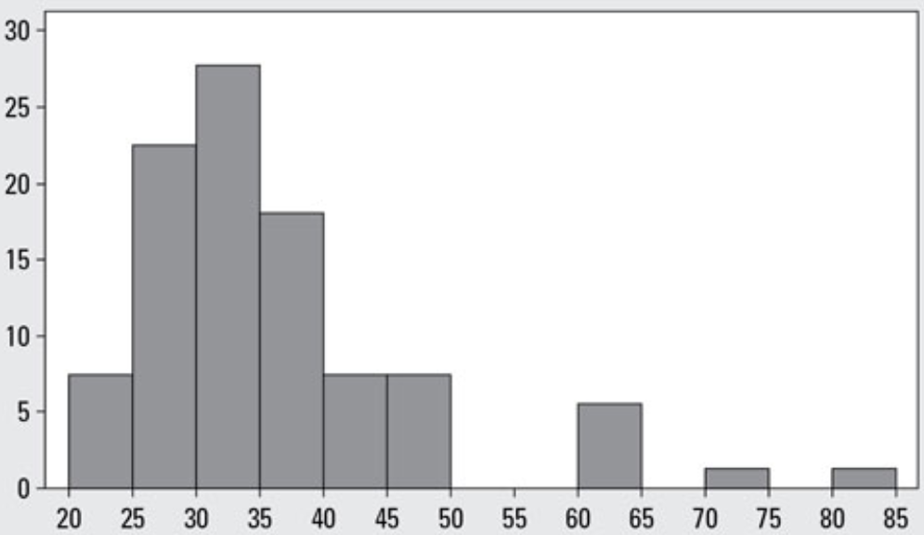
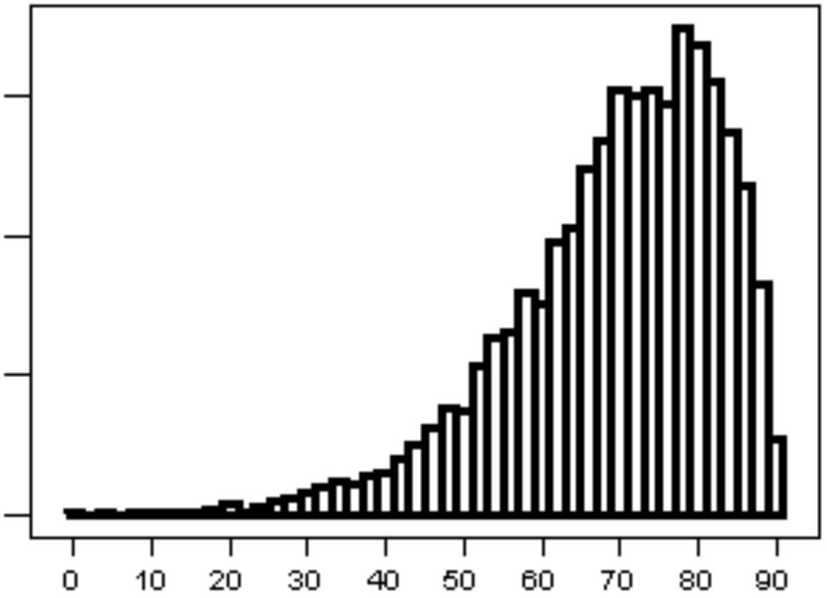
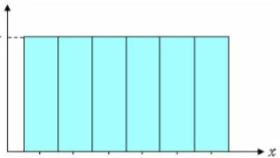
Ex: Match each scenario with a proper density curve:
A) Ages of female actresses that win the Oscars
B) The chances of rolling a number from 1 to 6 on a die
C) Age that people die from pneumonia

Slide 26
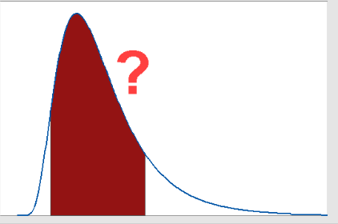
Chebyshev’s Inequality:
Suppose your distribution is not normally distributed, but skewed, bimodal, tri-modal, or whatever
If you want to know the “minimum” percentage of data within a certain standard deviation from the mean, we would use Chebyshev’s Inequality
Chebyshev’s Inequality gives us the minimum percentage of observations that will be within “k” standard deviations of the mean, where “k>1”

Slide 27
Chebyshev’s Inequality:
Chebyshev’s Inequality gives us a minimum percentage of observations that will be within “k” standard deviations of the mean, where “k>1”
“k” is the number of standard dev. from the mean
Atleast 17.35% of observation
will be within 1.1σ of the mean
ie: k = 2
Atleast 75% of observation
will be within 2σ of µ
89% of observation
will be within 3σ of µ
93.75% of observation
will be within 4σ of µ
A min. of 75% of observations will be within 2 std dev. of the mean
96% of observation
will be within 5σ of µ

Slide 28
Ex: The mean score of an Insurance Commission Licensure Examination is 82, with a standard deviation of 8. What percentage of the data set lies between 58 and 106? (symmetrical)
The mean age of salesladies in an ABC department store is 30, with a standard deviation of 6 . Between which two age limits must 75% of the data set lie?
First find “k”, for the number of std dev. in the range
A minimum of 93.75% of observations lie between 58 to 106
Add/Subtr 2 std dev. from the mean
First find “k” to know how many std dev. from the mean you need to get a minimum of 75% of observations
The ages of 75% of the salesladies must
lie between 18 and 42 years old.

Slide 29
Homework
P119 Q2.3, Q2.6
P132 Q2.16, 2.17, Q2.18,

